Slide 1
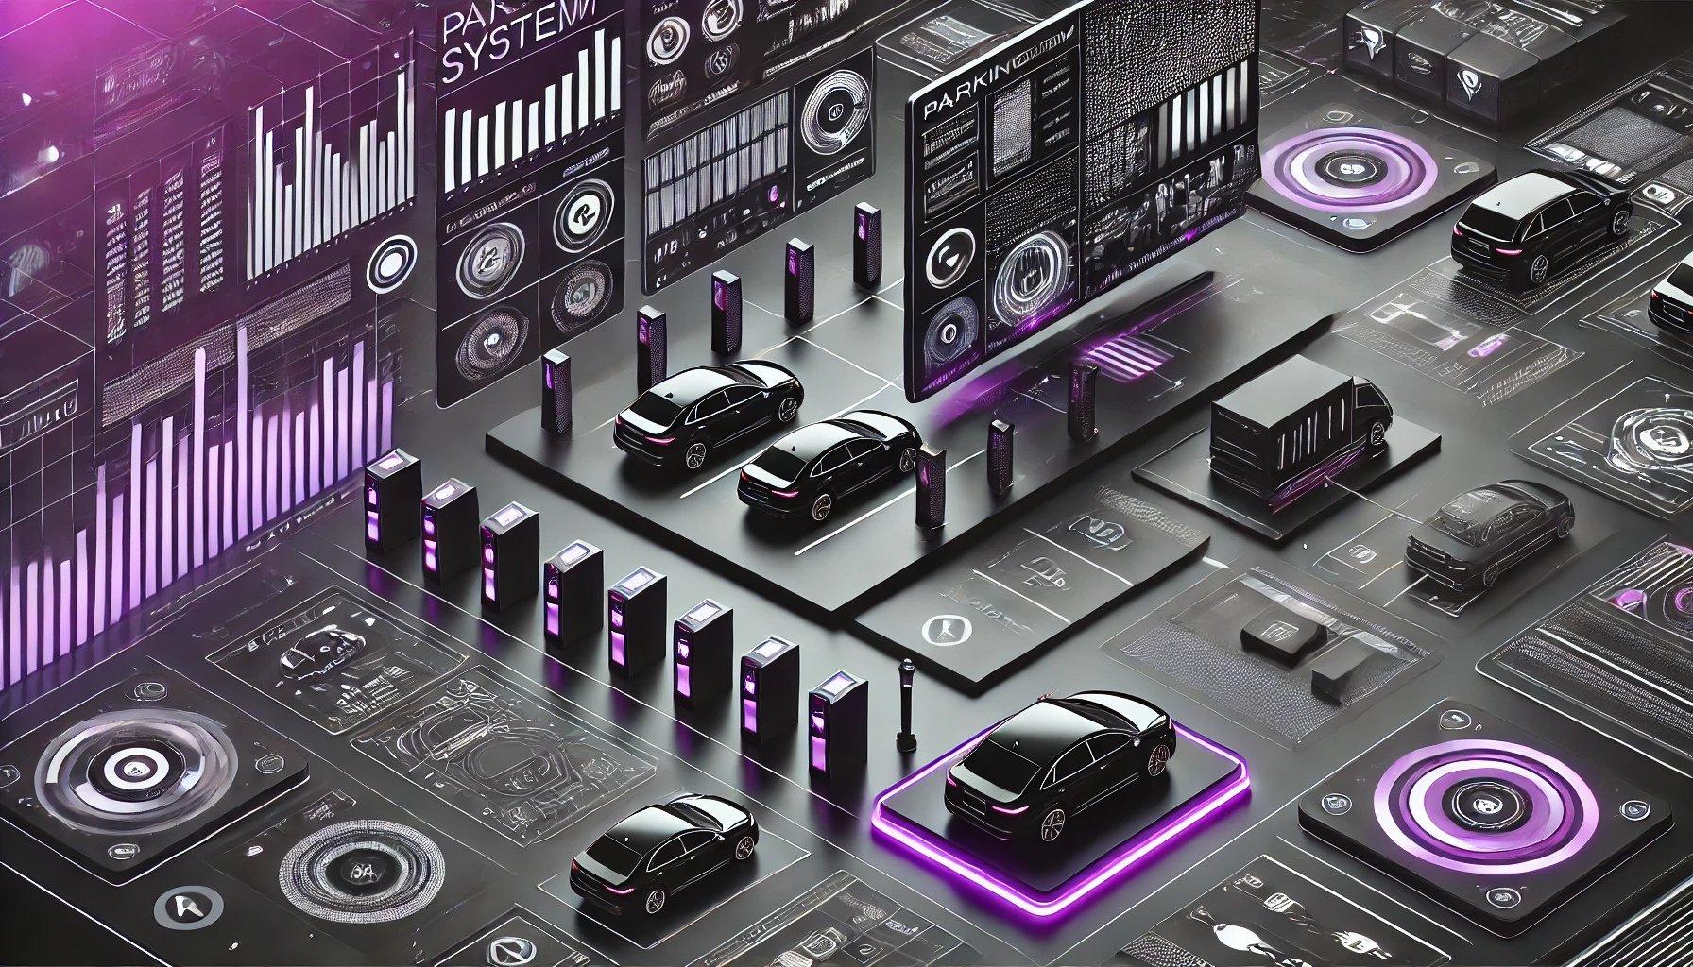
VEHICLE MANAGEMENT SYSTEM

Slide 2

Presented By:
Tasnia Taher Esha
2023-1-60-173
Abdul Wadud Priyo
2022-2-60-133
Ohiduzzaman Rayhan
2023-1-60-108
Presented To :
Dr. Md. Atiqur Rahman

Slide 3
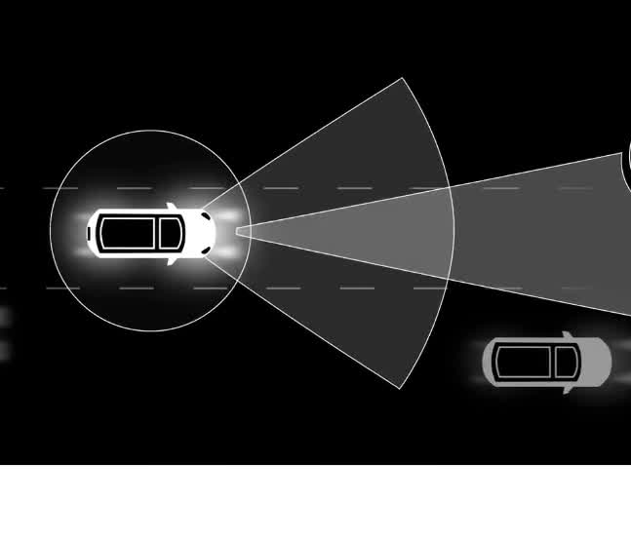
Introduction to vehicle Analysis System
01

Slide 4
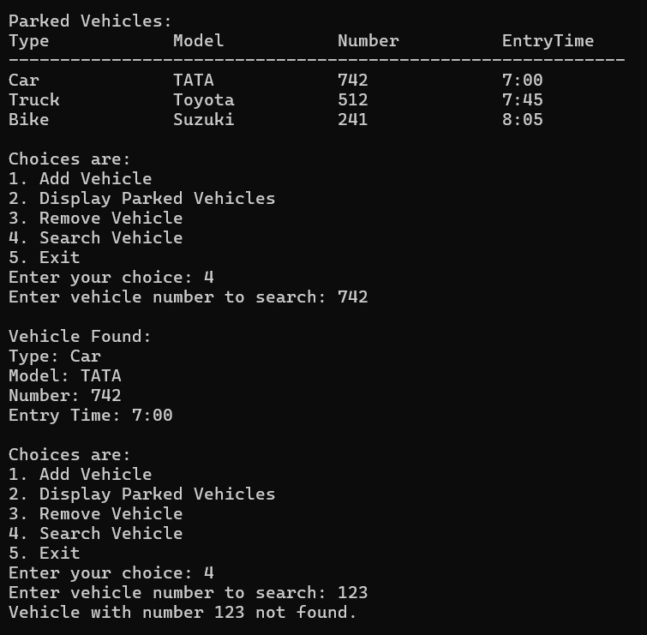
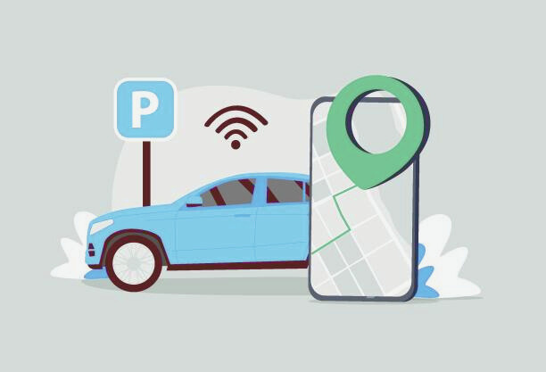
Search Vehicle

Slide 5
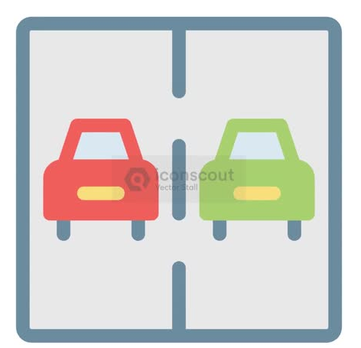


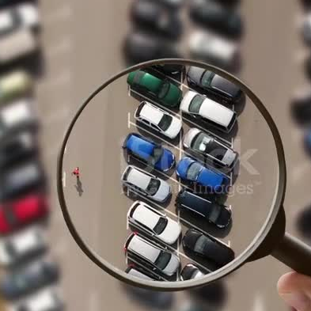

Features
01
02
03
04
05
Add Vehicle
Display Parked vehicles
Remove Vehicle
Search Vehicle
Exit
06
www.reallygreatsite.com

Slide 6
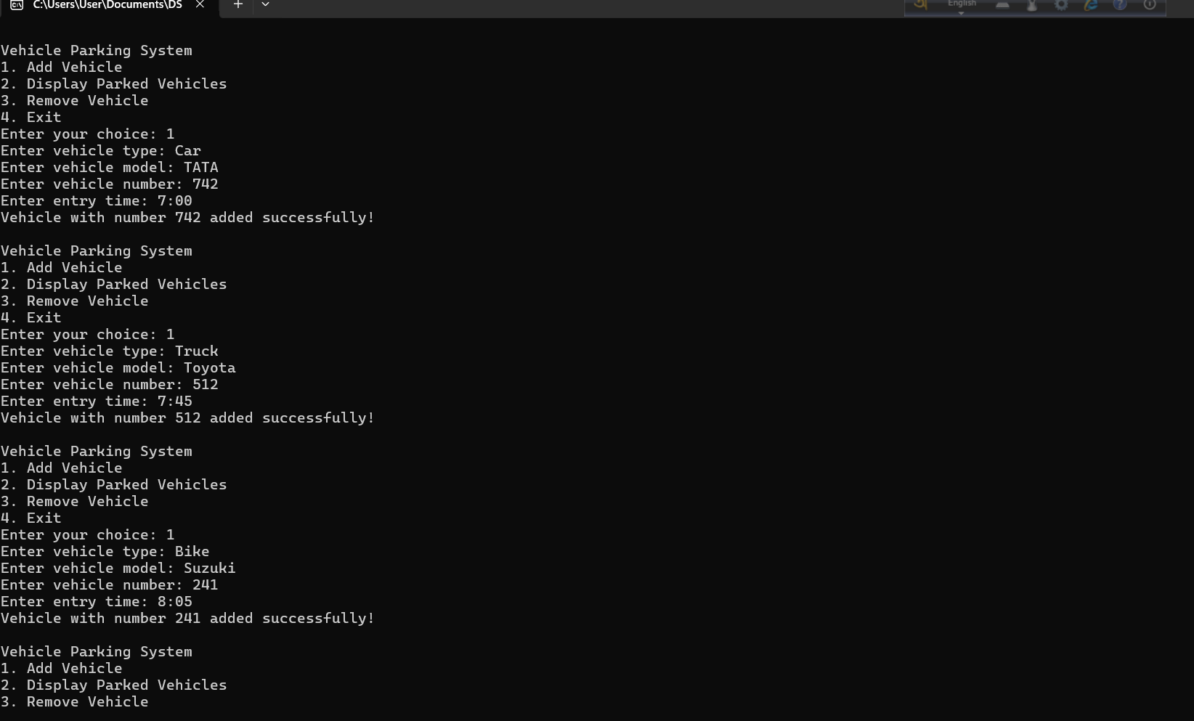
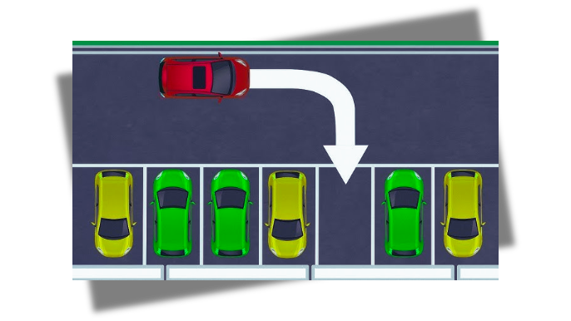
Add vehicle

Slide 7
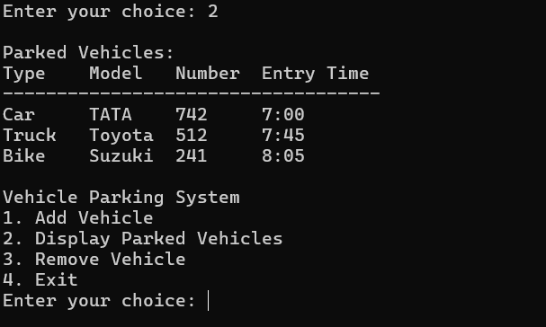
Display Parked Vehicles

Slide 8
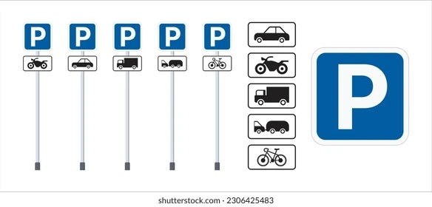
Display Parked vehicles

Slide 9
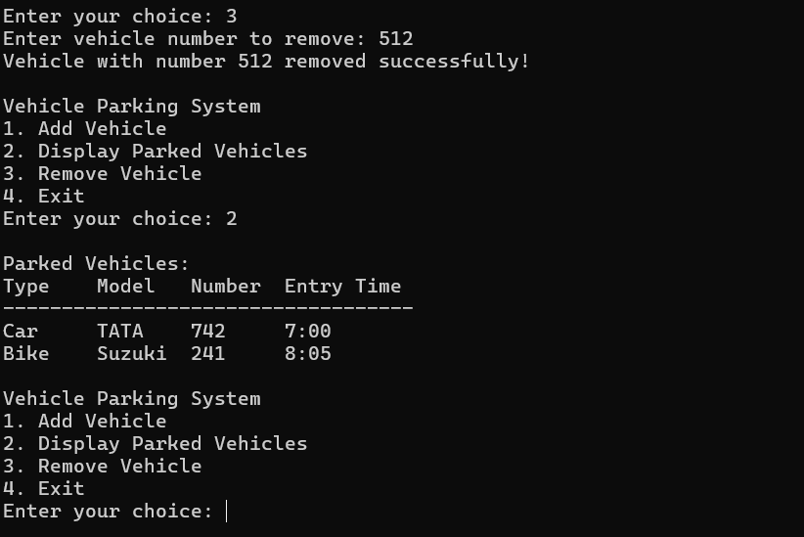
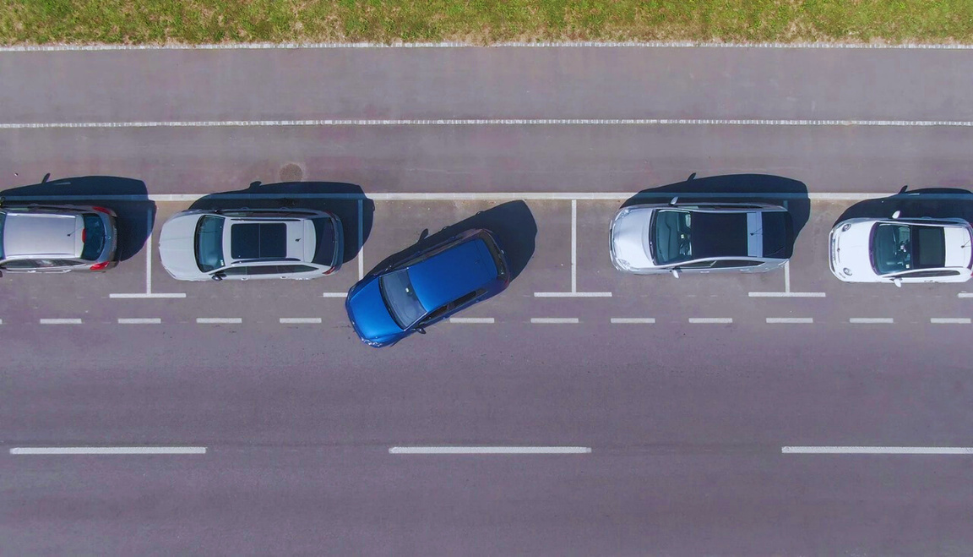
Remove vehicle

Slide 10
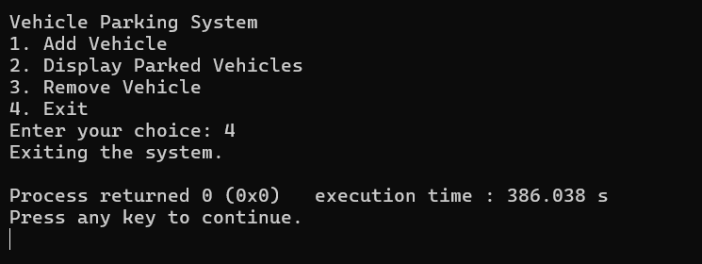
Exit
www.reallygreatsite.com

Slide 11
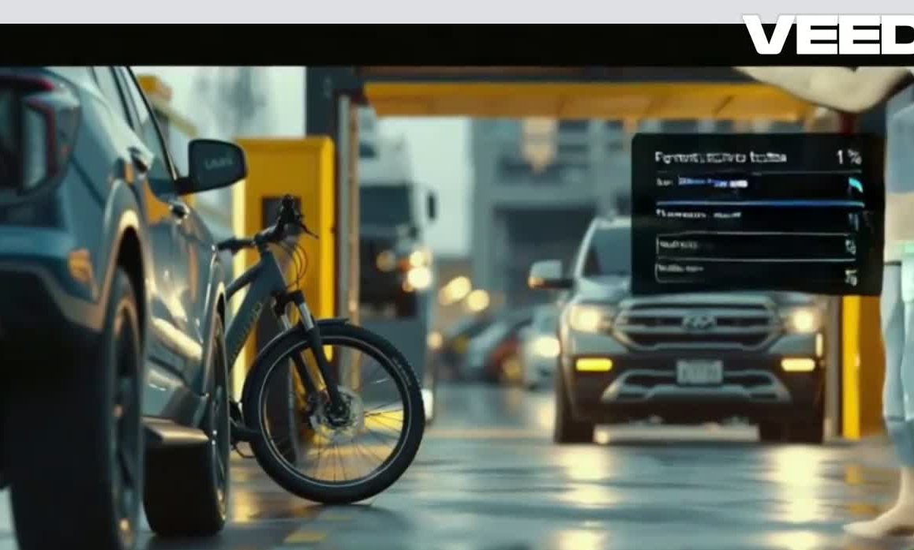
Thank You

Slide 12

Any question?

